Slide 1
SUPERSTORE SALES DASHBOARD Task 3 – Data Analyst Internship
Created by: Arya Mohan

Slide 2
Dataset Overview
Source: Kaggle – Global Superstore Sales.
Columns used: Category, Region, Sales, Profit, Quantity, Order, Date.
Objective: Analyze and visualize key sales metrics to provide business insights through an interactive dashboard.

Slide 3
Key Performance Indicators (KPIs)
Total Sales: ₹2.30M
Total Profit: ₹286.40K
Total Quantity Sold: 38K

Slide 4
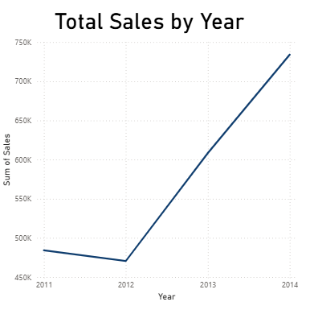
Sales Trends Over Time
A line chart shows the total sales growth across the years.
Sales were lowest in 2012 and showed consistent growth until 2014.

Slide 5
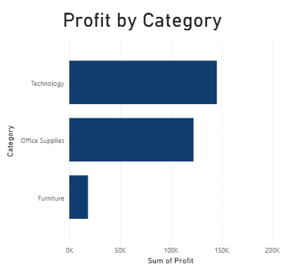
Profit by Product Category
Technology category generated the highest profit.
Office Supplies and Furniture followed behind.

Slide 6
Thank you

